Slide 1
HMH Science Dimensions
Biology
Unit 4: Ecosystems: Stability and Change
Notes:
Performance Expectations
HS-LS2-1 Use mathematical and/or computational representations to support explanations of factors that affect carrying capacity of ecosystems at different scales.
HS-LS2-2 Use mathematical representations to support and revise explanations based on evidence about factors affecting biodiversity and populations in ecosystems of different scales.
HS-LS2-6 Evaluate the claims, evidence, and reasoning that the complex interactions in ecosystems maintain relatively consistent numbers and types of organisms in stable conditions, but changing conditions may result in a new ecosystem.

Slide 2

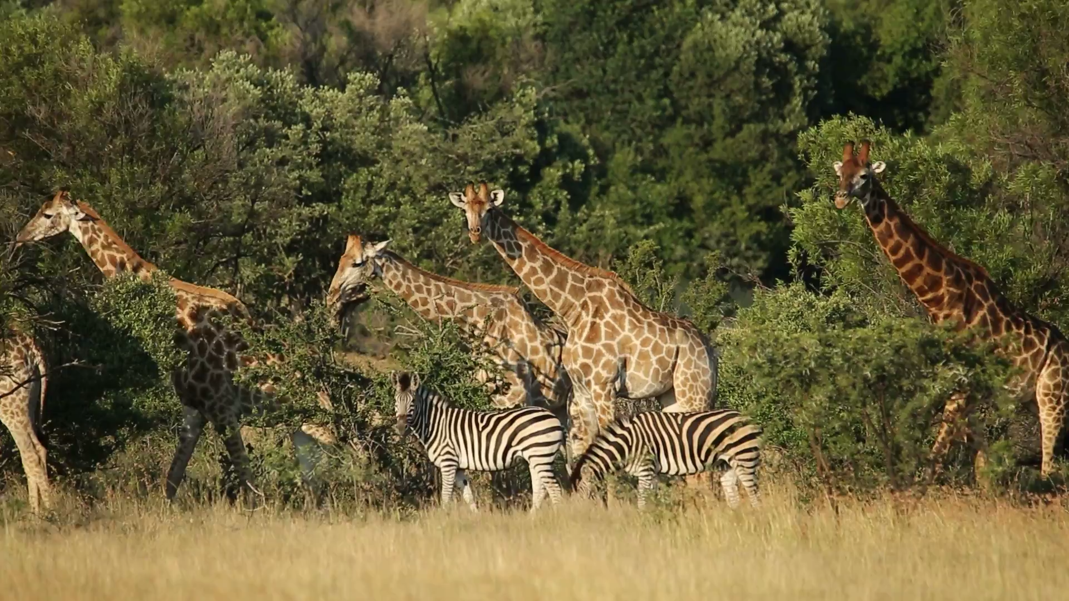
Ecosystems: Stability and Change
Unit 4
Populations are sensitive to changes in their environments

Slide 3

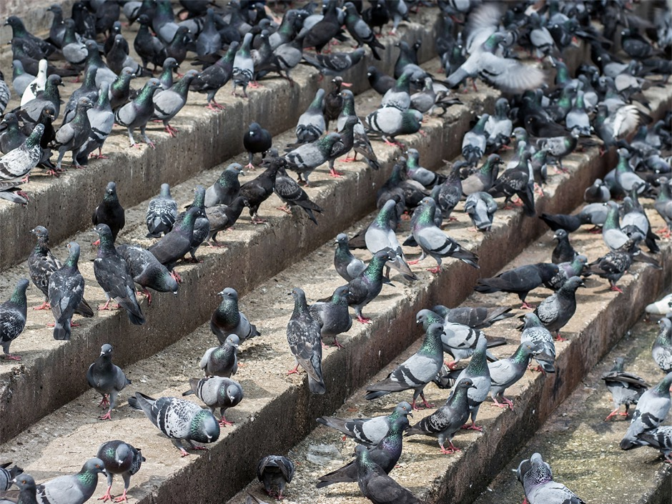

Ecosystems: Stability and Change
Unit 4
How do you think changes in population size can affect the composition and stability of an ecosystem?
Pigeon populations can grow out of control.

Slide 4
Driving Questions
Unit 4
As you move through the unit, gather evidence to help you answer the following questions:
1. How do scientists measure population and changes in population?
2. What causes populations and ecosystems to remain stable or to change over time?
3. What factors affect populations within an ecosystem?
4. How do modest or drastic changes in ecosystems affect ecosystem stability?

Slide 5

Unit Project
Unit 4
Wetlands at Your Service
How do wetlands help stabilize ecosystems and populations?
How might the destruction of wetlands change the composition of populations and ecosystems?
Notes:
Wetlands at Your Service Students design and build a model wetland and use it to investigate the complex interactions in a wetland ecosystem, and how changes to the ecosystem affect the numbers of organisms living there. Students use evidence from their observations to construct mathematical models that explain factors affecting carrying capacity, biodiversity, and populations within the wetland ecosystem.

Slide 6
Unit Review
Unit 4
Synthesize the Unit
Make a concept map, other graphic organizer, or outline using the Study Guides you made for each lesson in this unit. Be sure to use evidence to support your claims.
When synthesizing individual information, remember to follow these general steps:
Find the central idea of each piece of information.
Think about the relationships among the central ideas.
Combine the ideas to come up with a new understanding.

Slide 7
Image Credits
Unit 4
pigeons ©Milkovasa/Shutterstock; giraffes and zebras video ©EcoPrint/Shutterstock

